Slide 1
Adapter Pattern
Student: Seitkazy Kazybek

Slide 2
Introduction
Imagine you're traveling and you have a device with a European plug, but when you arrive in the US, you realize that all the sockets there are American. To use your device, you need an adapter. This is an example of the adapter pattern in real life. Today, we'll be looking at how this pattern can be implemented in code, by adapting a European device to work with an American socket.

Slide 3
The Adapter Pattern
The Adapter Pattern allows incompatible interfaces to work together. It creates a middle layer, called the adapter, that translates one interface into another. In our case, the European plug (the device) and the American socket have different interfaces, so we need an adapter that can make them compatible.

Slide 4
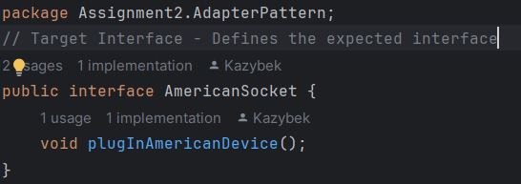
About the codes
Target Interface (AmericanSocket)
This is the interface for an American socket, which the client system understands. The PlugInAmericanDevice method allows American devices to be connected to it.

Slide 5
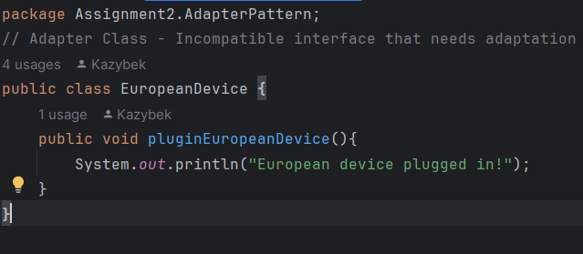
About the codes
B) Adapter Class (EuropeanDevice)
This class represents a European device that can only be plugged into European sockets. The plugInEuropeanDevice method is incompatible with American sockets.

Slide 6
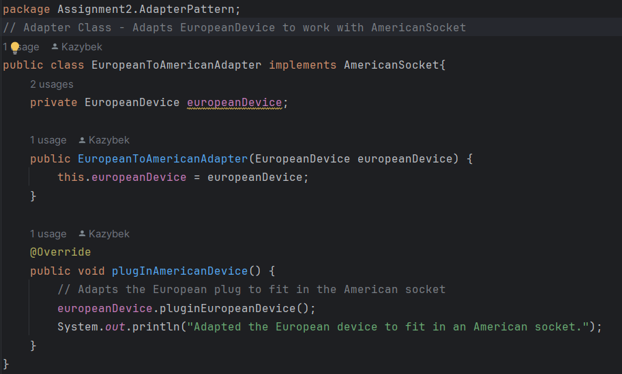
About the codes
C) Adapter Class (EuropeanToAmericanAdapter)
The adapter class implements the American socket interface, allowing a European device to function with an American power outlet. The adapter converts the European plug into a format that fits into the American outlet.

Slide 7
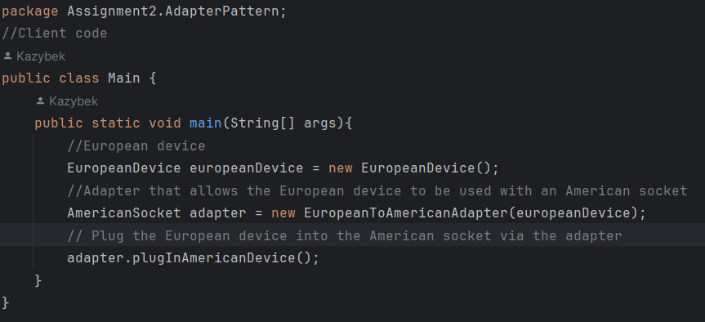
About the codes
D) Client code
Here, the client code interacts with the American Socket interface. However, we use an adapter to connect a European device to the American socket, translating it for compatibility.

Slide 8
Why I Chose the Adapter Pattern
I chose the Adapter Pattern because it is an excellent solution when we need to integrate incompatible systems—in this case, a European device with an American socket. The adapter acts as a translator, allowing the two systems to work together without changing their underlying structure.

Slide 9
Question
Now, can anyone think of other examples in the real world where adapters are commonly used besides power sockets?

Slide 10
Examples
HDMI to VGA adapters, USB-C to USB-A adapters

Slide 11
Conclusion
In summary, the Adapter Pattern is useful when there are two incompatible interfaces that need to communicate with each other. By using an adapter, we can make existing systems, like a European device, work with new systems, like an American socket, without having to modify their internal workings.

